Slide 1
Microsoft Office Excel 2003
Tutorial 1 – Using Excel To Manage Data

Slide 2
Identify major components of the Excel window
Excel is a computerized spreadsheet, which is an important business tool that helps you report and analyze information.
Excel stores spreadsheets in documents called workbooks.
Each workbook is made up of individual worksheets, or sheets.
Because all sorts of calculations can be made in the Excel spreadsheet, it is much more flexible than a paper spreadsheet.
The Excel window has some basic components, such as an Active cell, Column headings, a Formula bar, a Name box, the mouse pointer, Row headings, Sheet tabs, a Task Pane, Tab scrolling buttons and Toolbars.

Slide 3
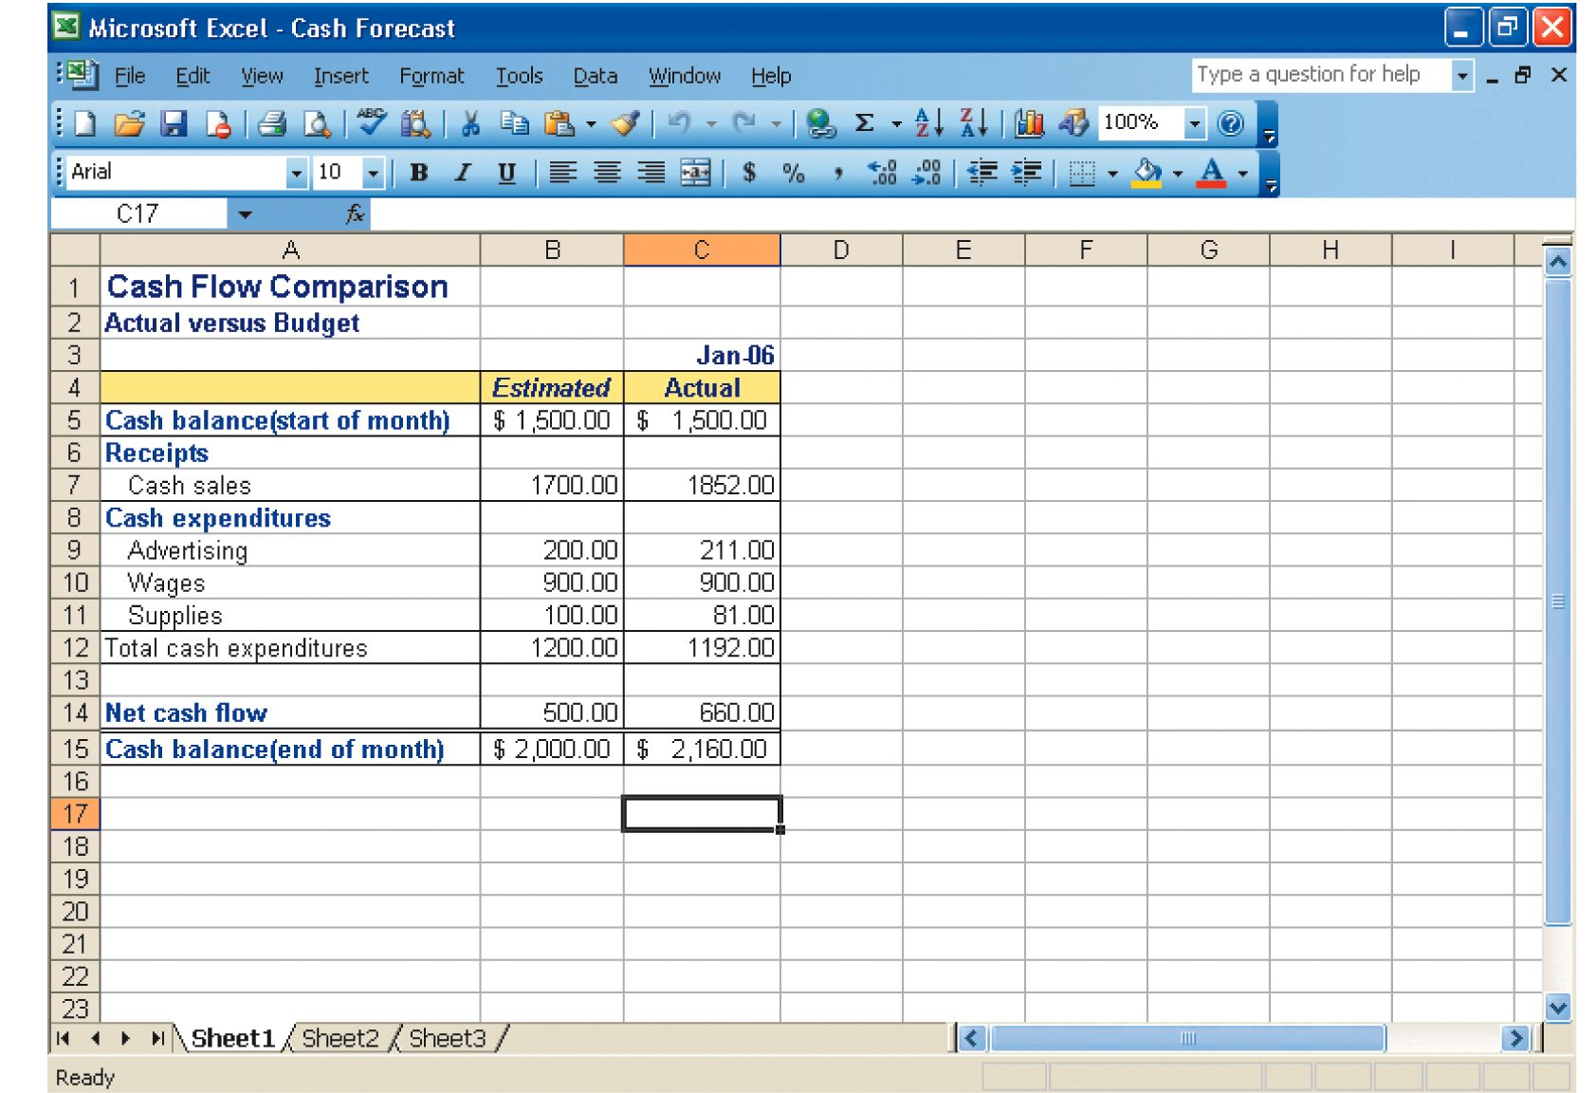
A sample Excel worksheet

Slide 4
Excel worksheets and workbooks
When you set up calculations in a worksheet, if an entry is changed in a cell, the spreadsheet will automatically update any calculated values that were based on that entry.
When you open Excel, by default it will open a blank workbook with three blank worksheets.
When you save a workbook, you have a Save As option that can save the spreadsheet to earlier versions of Excel or to Quattro Pro, Lotus 123 formats, dBase formats, and even to a comma or tab-delimited text file.

Slide 5
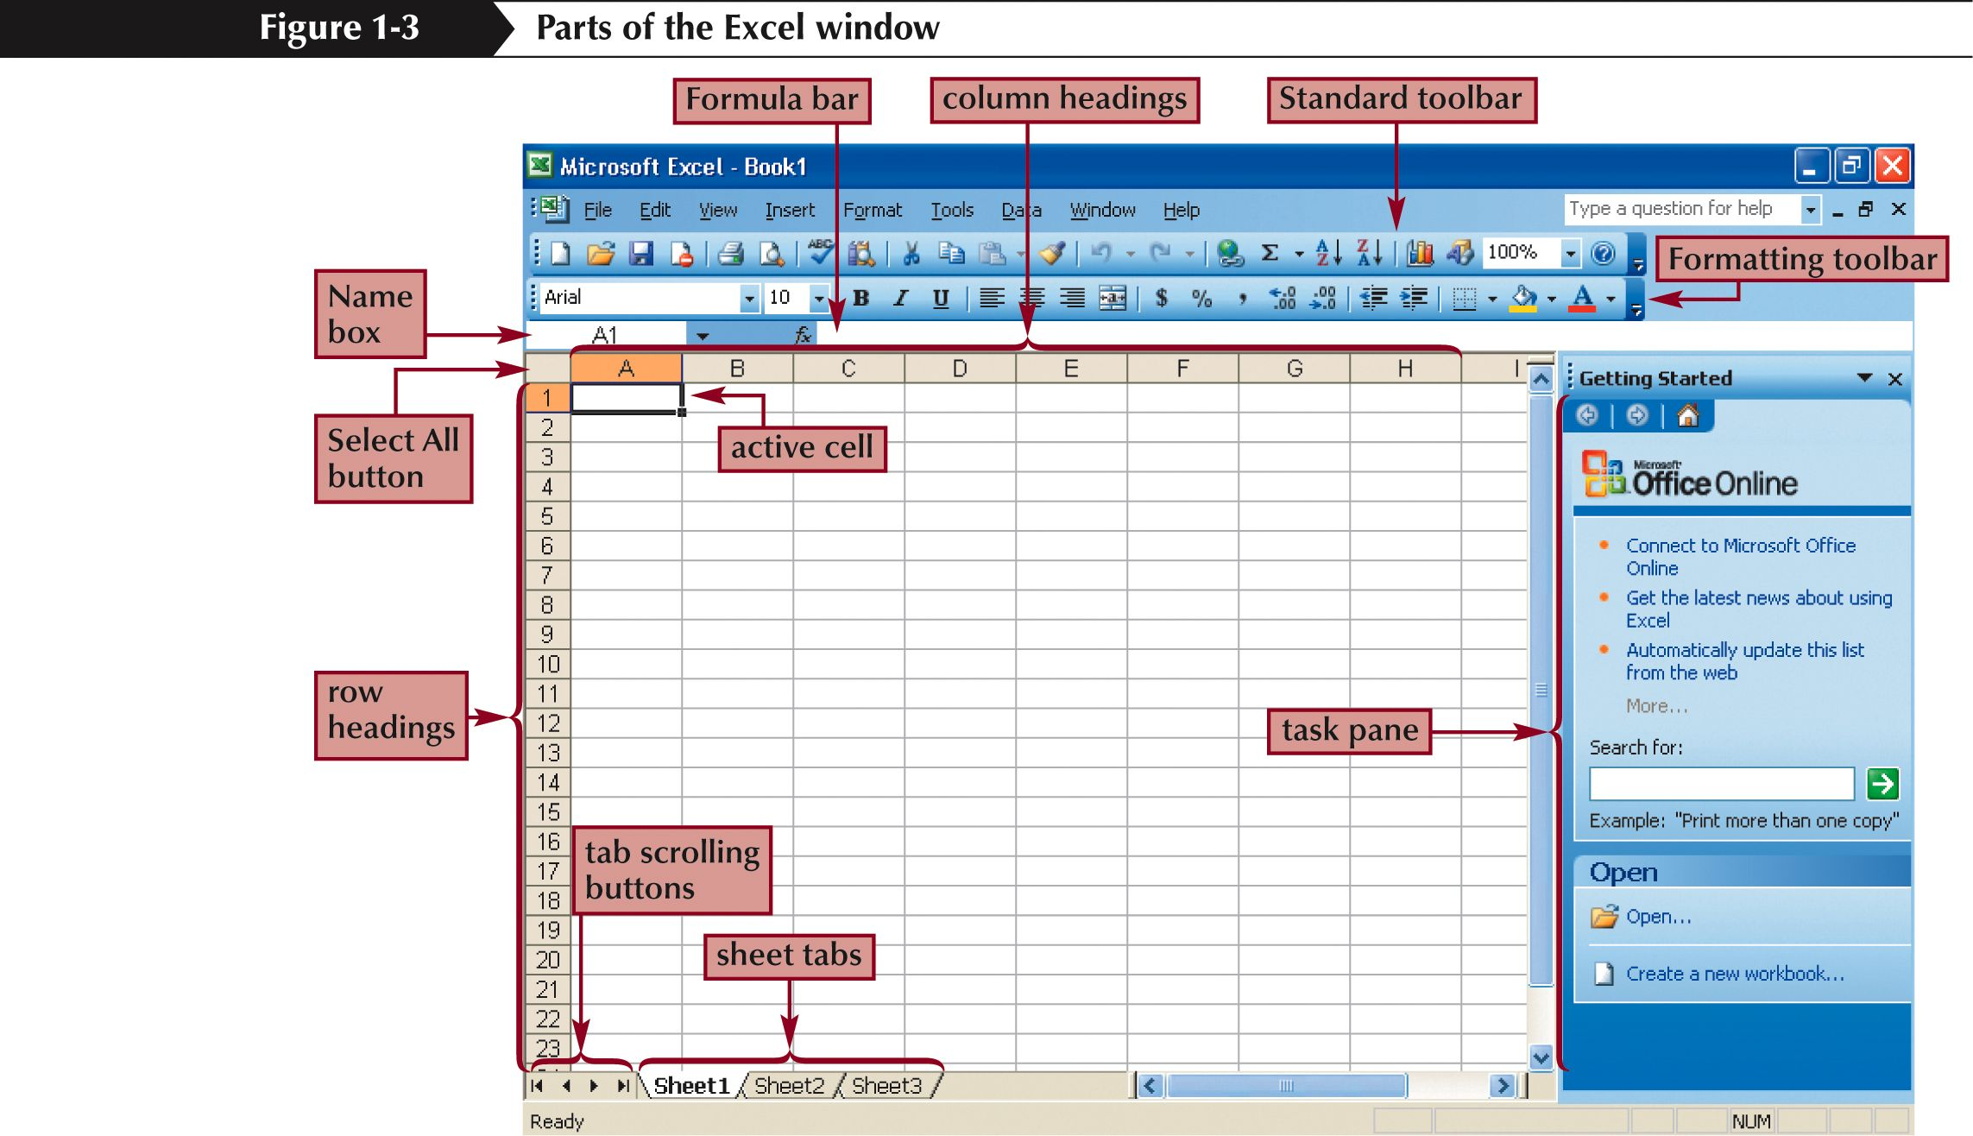
Identify Excel components

Slide 6
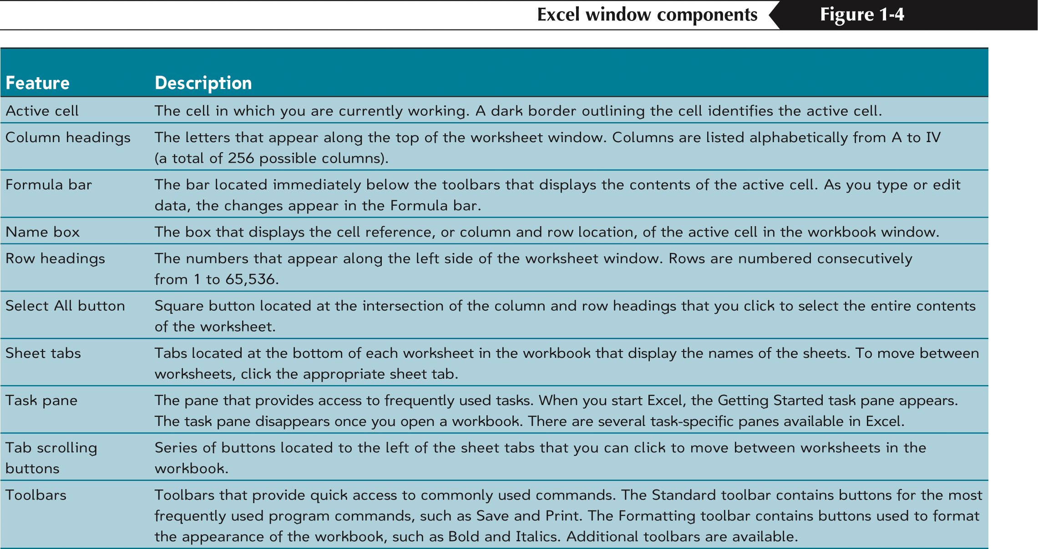
Descriptions of Excel components

Slide 7
Navigate within worksheets
To navigate within a workbook, you use the arrow keys, PageUp, PageDown, or the Ctrl key in combination with the arrow keys to make larger movements.
The most direct means of navigation is with your mouse.
Scroll bars are provided and work as they do in all Windows applications.

Slide 8
Navigate between worksheets
To move to other Worksheets, you can:
  Click their tab with the mouse
  Use the Ctrl key with the Page Up and Page Down keys to move sequentially up or down through the worksheets
If you are familiar with Microsoft Access, you will find the tab scrolling buttons for moving between worksheets to be similar to record browsing on an Access form or datasheet.

Slide 9
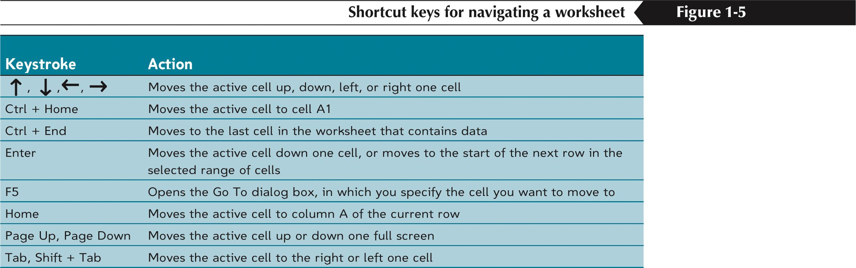
Navigation keystrokes

Slide 10
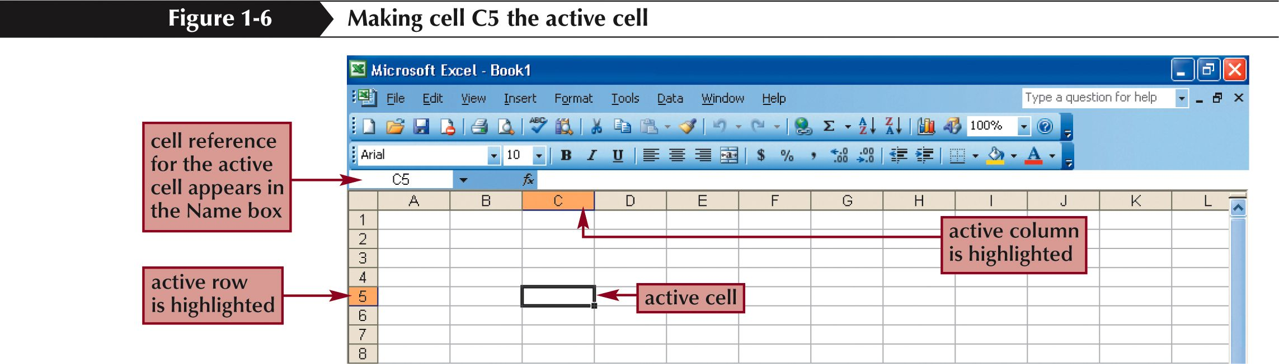
The Active Cell

Slide 11
Developing a Worksheet
Determine the worksheet’s purpose.
Enter the data and formulas.
Test the worksheet and make any necessary edits / corrections.
Document the worksheet and improve appearance.
Save and print the complete worksheet.

Slide 12
Entering Data into a Worksheet
To enter data, first make the cell in which you want to enter the data active by clicking it.
Enter the data (text, formulas, dates, etc.) into the active cell.
Use the Alt+Enter key combination to enter text on multiple lines within the same cell.
Use TAB key, arrow keys, or ENTER key to navigate among the cells.

Slide 13
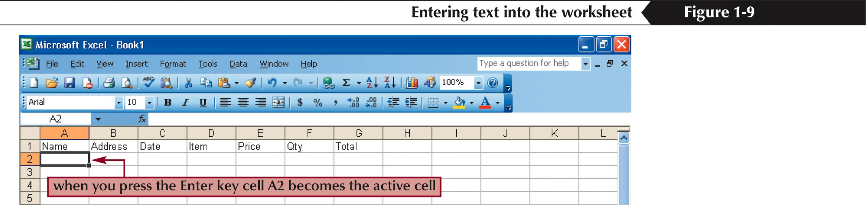
Entering Data into a Worksheet

Slide 14
Entering Formulas
A formula is a mathematical expression that calculates a value.
In Excel, formulas always begin with an equal sign (=).
A formula can consist of one or more arithmetic operators.
The order of precedence is a set of predefined rules that Excel follows to calculate a formula.

Slide 15
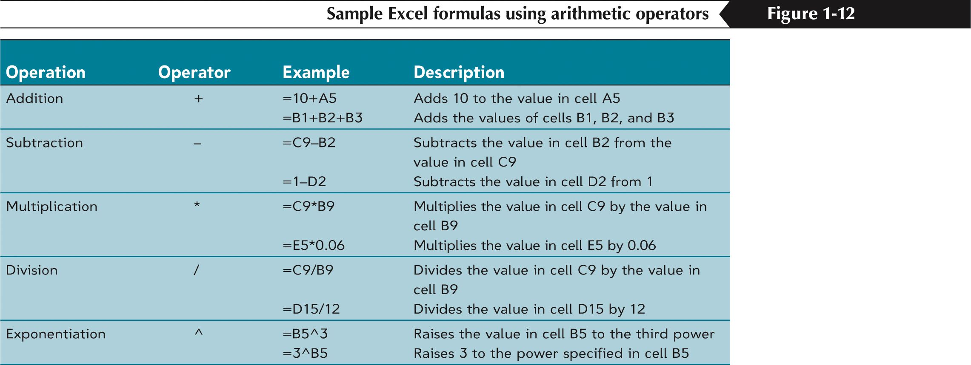
Arithmetic Operators

Slide 16
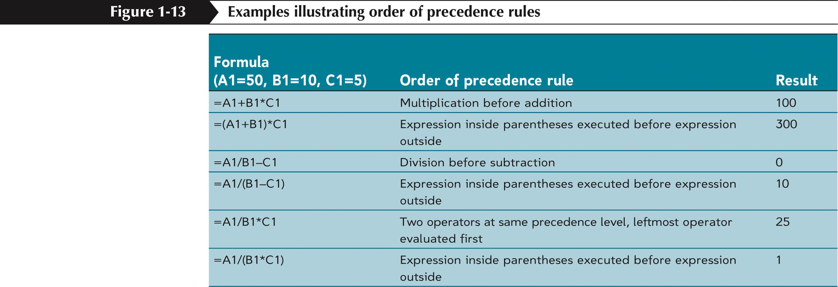
Order of Precedence Rules

Slide 17
Resize worksheet rows and columns
There are a number of methods for altering row height and column width using the mouse or menus:
  Click the dividing line on the column or row, and drag the dividing line to change the width of the column or height of the row
  Double-click the border of a column heading, and the column will increase in width to match the length of the longest entry in the column
Widths are expressed either in terms of the number of characters or the number of screen pixels.

Slide 18
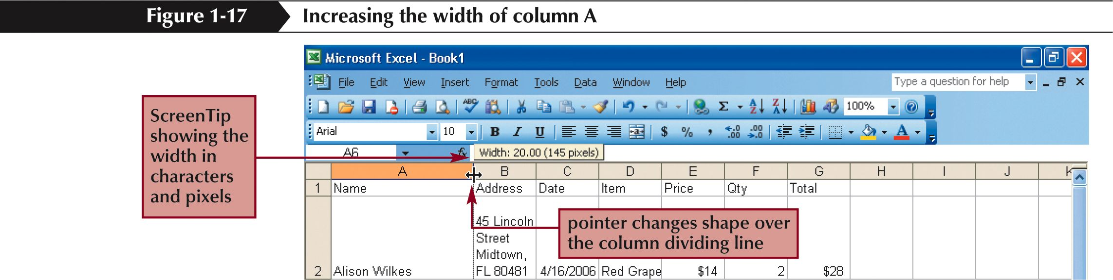
Resize a column

Slide 19
Identify cell ranges
A group of worksheet cells is known as a cell range, or range.
Working with ranges in a worksheet makes working with the data easier.
Ranges can be adjacent or nonadjacent.
  An adjacent range is a single, rectangular block of cells
  Select an adjacent range by clicking on a cell and dragging to an opposite corner of a rectangle of cells
  A nonadjacent range is comprised of two or more adjacent ranges that are not contiguous to each other
  To select a nonadjacent range, begin by selecting an adjacent range, then press and hold down the Ctrl key as you select other adjacent ranges

Slide 20
Select and move worksheet cells
To select a large area of cells, select the first cell in the range, press and hold the Shift key, and then click the last cell in the range.
Once you have selected a range of cells, you may move the cells within the worksheet by clicking and dragging the selection from its current location to its new one.
By pressing and holding the Ctrl key as you drag, Excel will leave the original selection in its place and paste a copy of the selection in the new location.
To move between workbooks, use the Alt key while dragging the selection.

Slide 21
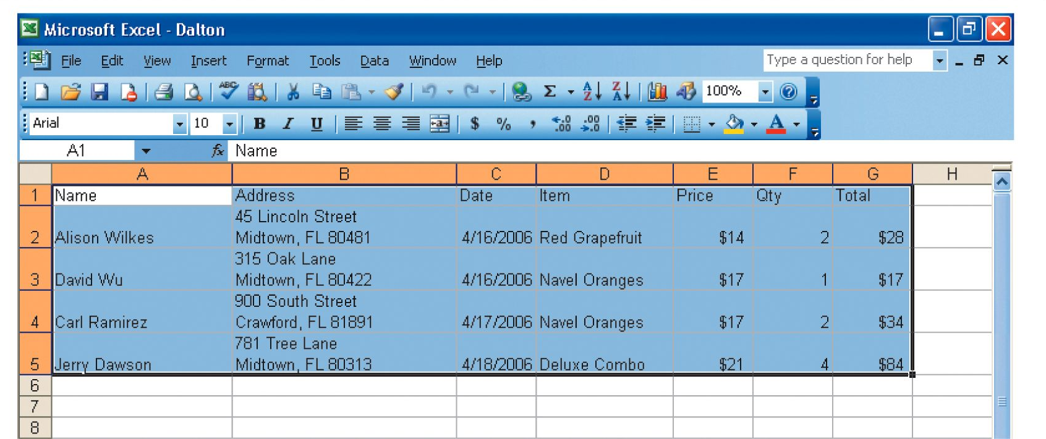
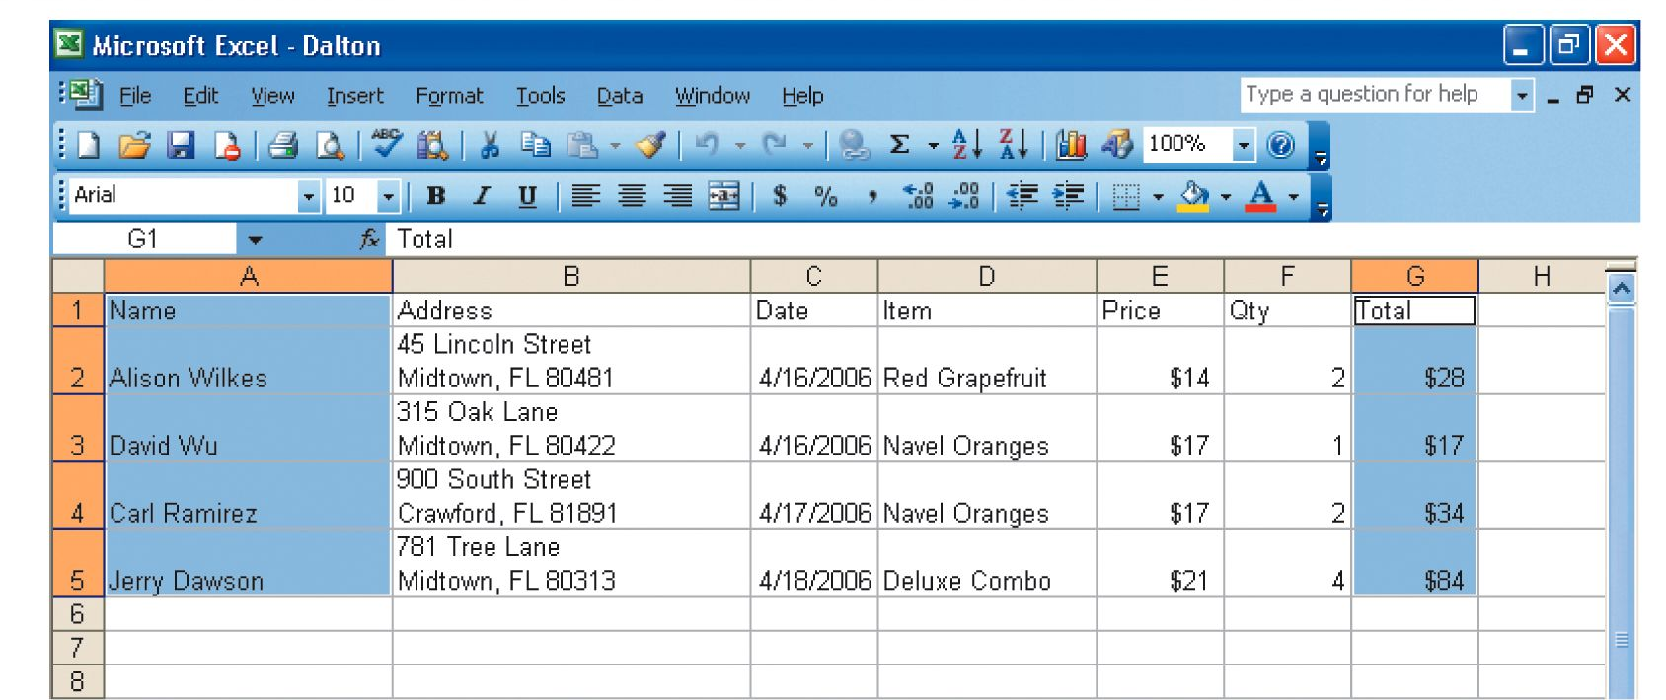
Adjacent and nonadjacent ranges

Slide 22
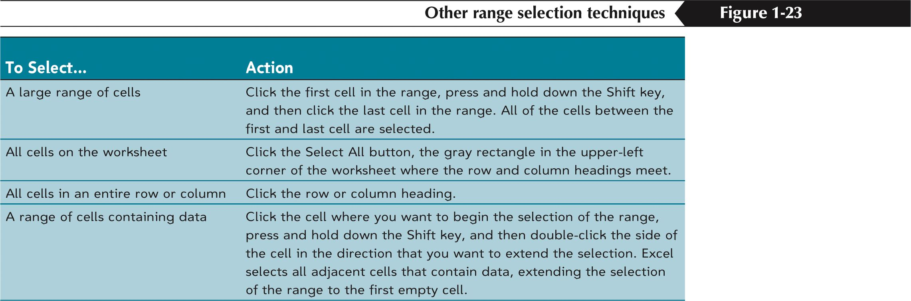
Range selection techniques

Slide 23
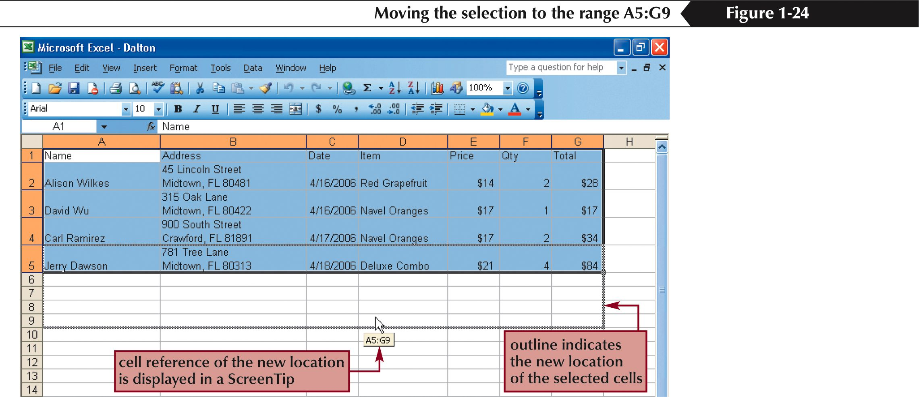
Moving selected cell ranges

Slide 24
Insert worksheet rows and columns
You can insert one or many additional rows or columns within a worksheet with just a few steps using the mouse or menu options.
You can insert individual cells within a row or column and then choose how to displace the existing cells.
You can click the Insert menu and then select row or column, or right click on a row or column heading or a selection of cells and then choose Insert from the shortcut menu.

Slide 25
Delete worksheet rows and columns
To delete and clear cells, rows, or columns, you can use the Edit menu, or right click on a heading or a selection of cells and choose Delete from the shortcut menu.
Clearing, as opposed to deleting, does not alter the structure of the worksheet or shift uncleared data cells.
What can be confusing about this process is that you can use the Delete key to clear cells, but it does not remove them from the worksheet as you might expect.

Slide 26
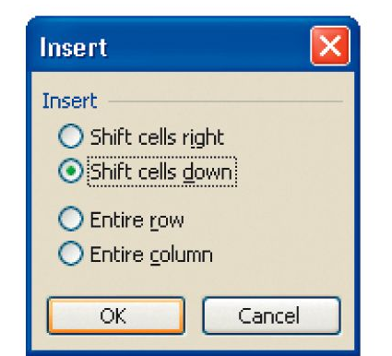
The Insert dialog box

Slide 27
Use the Undo and Redo features
Editing is an intrinsic task in any document, and especially useful are the Undo and Redo actions.
The Undo feature allows you to sequentially back up to a certain action, such as a delete, a move, an entry, etc. and allows you to reverse those actions.
Redo allows you to reapply actions one step at a time that you have previously undone.

Slide 28
Insert, move, and rename worksheets
Worksheets are much like pages within a book; you peruse through them like you flip the pages of a book.
There are several ways to move, copy and work with worksheets.
Right click on the sheet tab and choose Move or Copy. Select a new position in the workbook for the worksheet or click the Create a copy checkbox and Excel will paste a copy of that worksheet in the workbook.
The same shortcut menu for the sheet tab also gives you the option to insert, delete or rename a worksheet.

Slide 29
Print a workbook
To Print a worksheet, you can use:
  A menu
  The Print button on the standard toolbar
  The Ctrl-P keystroke to initiate a printout of the worksheet
Excel uses the same basic methods for printing as other Windows and Microsoft Office applications.

Slide 30
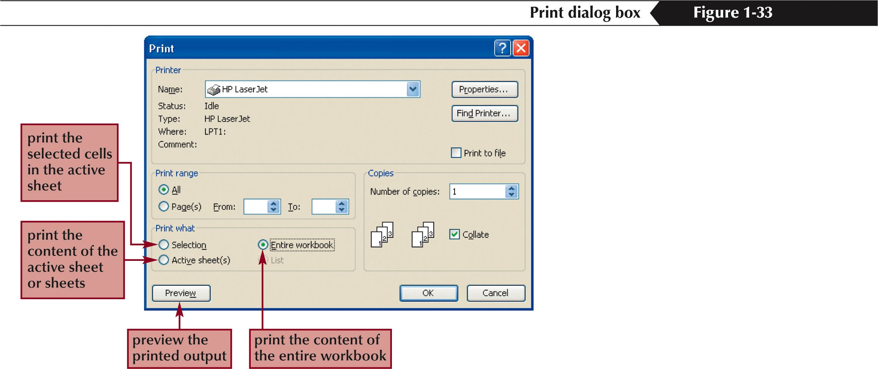
The Print dialog box

